Slide 1
Mobile App Security

Slide 2
Abstract
Mobile app security is the process of protecting mobile application from cyber threats and unauthorized access. It ensure that sensitive user data such as password and personal information remain safe. Strong mobile app security helps prevent data breaches and attacks

Slide 3
Agenda
1.Abstract
2.scope&limitations
3Tools&environment
4.App under test
5.Methodology
6.Static analysis finding
7.Dynamic analysis finding
8.Conclusion
9.Q&A

Slide 4
Objectives
To assess the security of a mobile application.
To identify vulnerabilities using static and dynamic analysis.
To understand secure coding practices and mitigation techniques.

Slide 5
Scope and limitation
scope
limitation
Security testing of InsecureBankv2 APK
Static analysis using JADX and APKTool
Review of app code and configuration
Testing performed in android emulator
Testing limited to local environment
Backend server not fully analysed
No real user data used
Certificate pinning not tested due to HTTP usage

Slide 6
Tools and environment
ADB
APK Tool
JADX GUI
Mobsf
Burp suite
Android studio (Emulator)

Slide 7
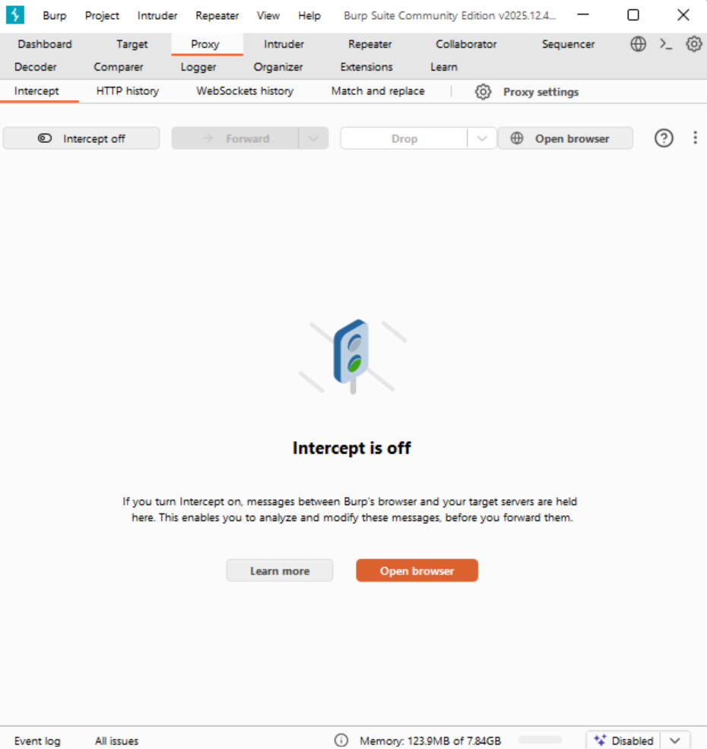
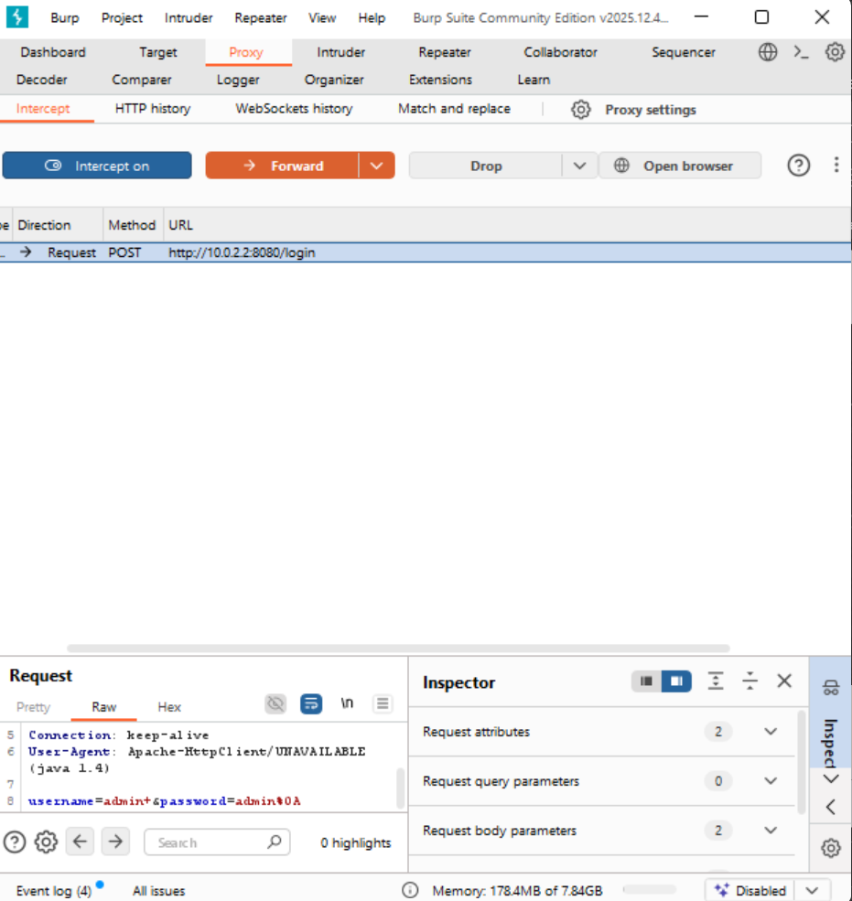
TOOLS AND ENVIRONMENTS
BURP SUITE

Slide 8

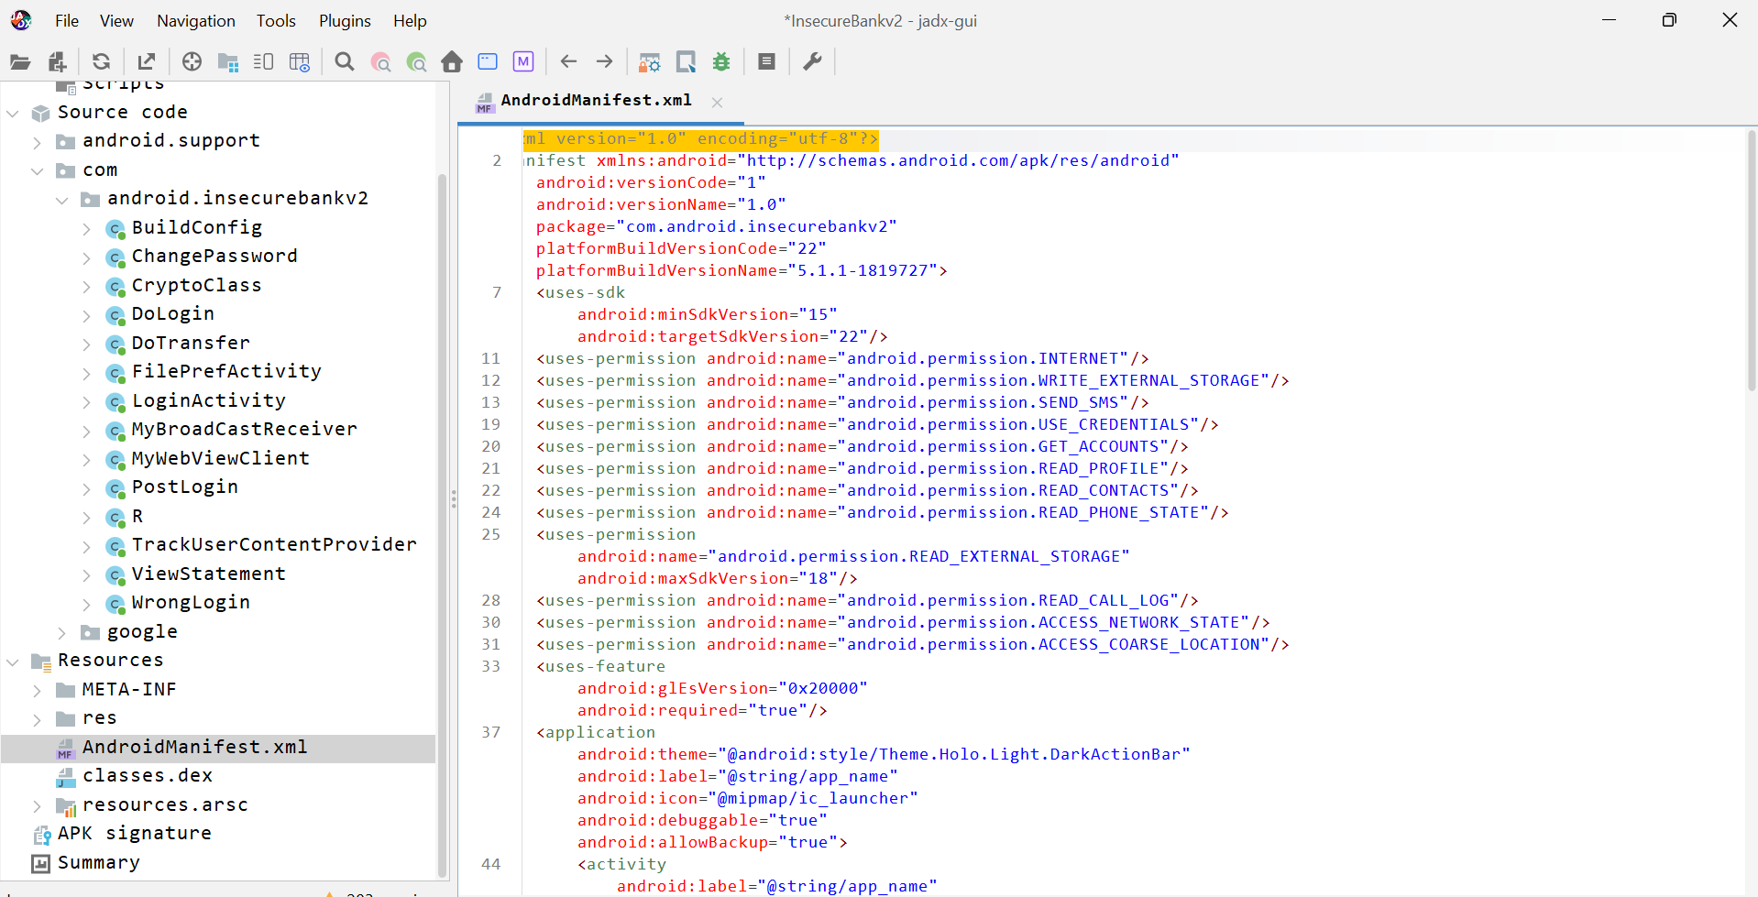
JADX GUI

Slide 9
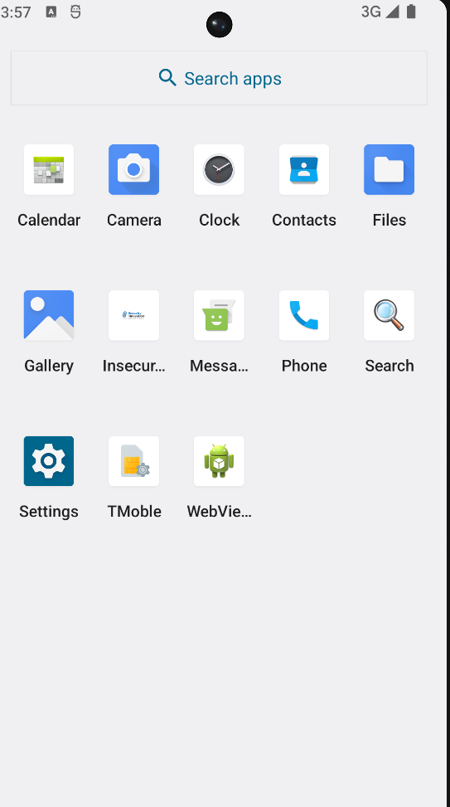

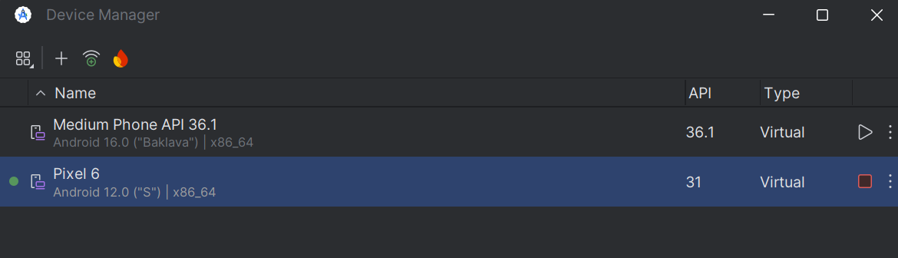
ANDROID EMULATOR

Slide 10
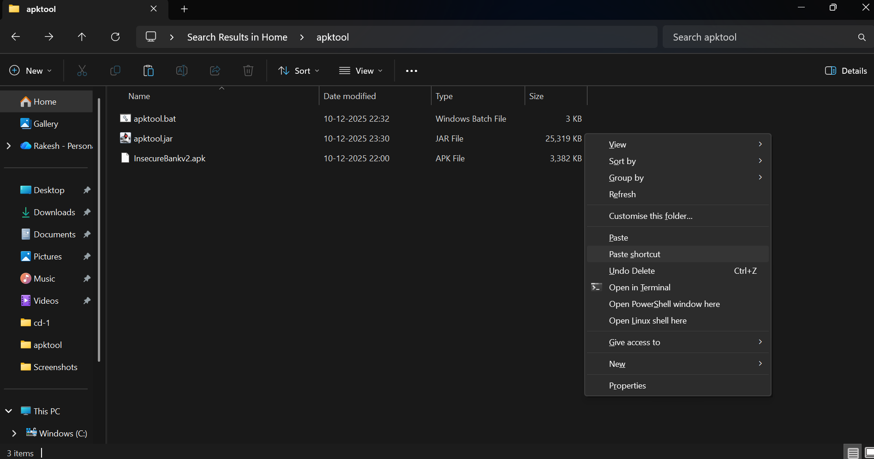
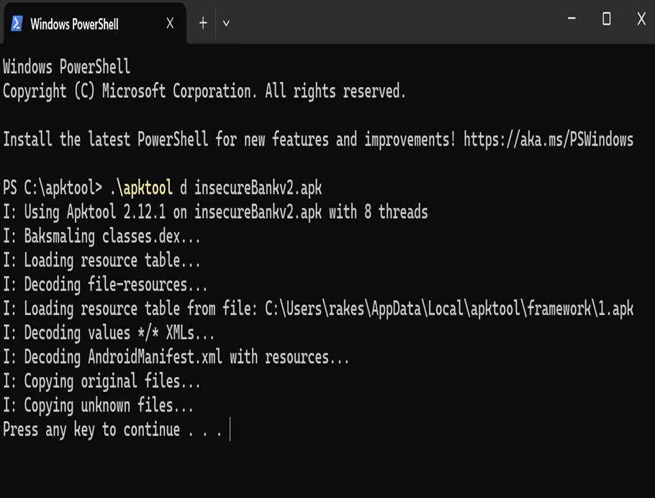
APKTOOL

Slide 11
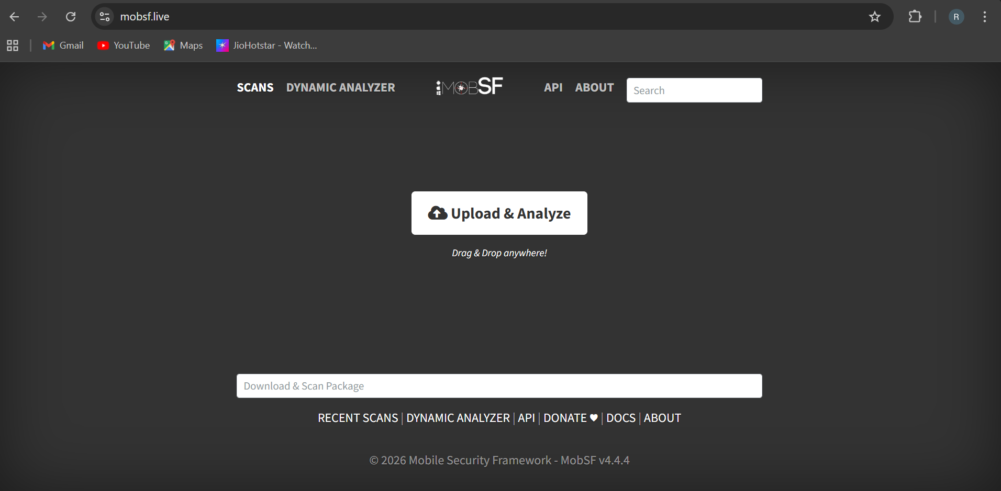
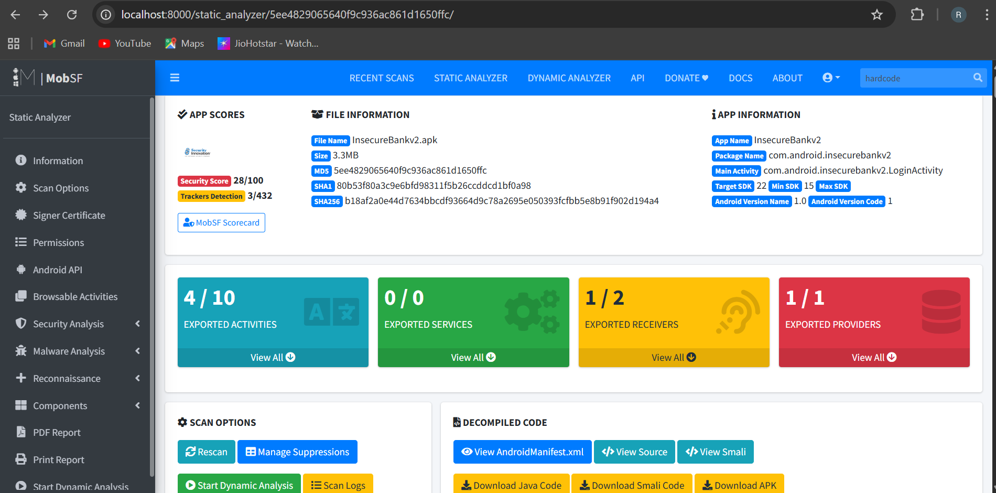
MOBSF

Slide 12
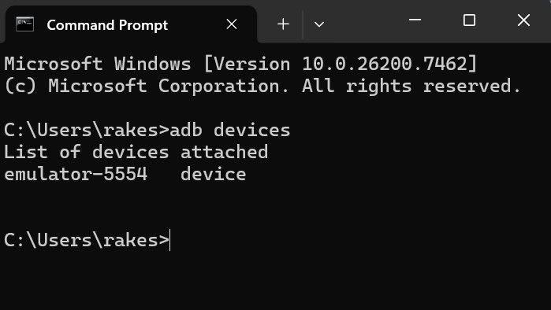
ADB DEVICES

Slide 13
APP UNDER TEST
Application name: insecureBankv2
Package name: com.android.insecurebankv2
Application type: android banking application
Version: vulnerable/test version
Source: publicly available security testing application

Slide 14
Methodology
Static Analysis
Automated Scan
Dynamic Analysis
Reporting

Slide 15
Statics analysis
Hardcoded Credentials
Plaintext Password Transmission
Insecure Local Storage
Missing Certificate Pinning

Slide 16
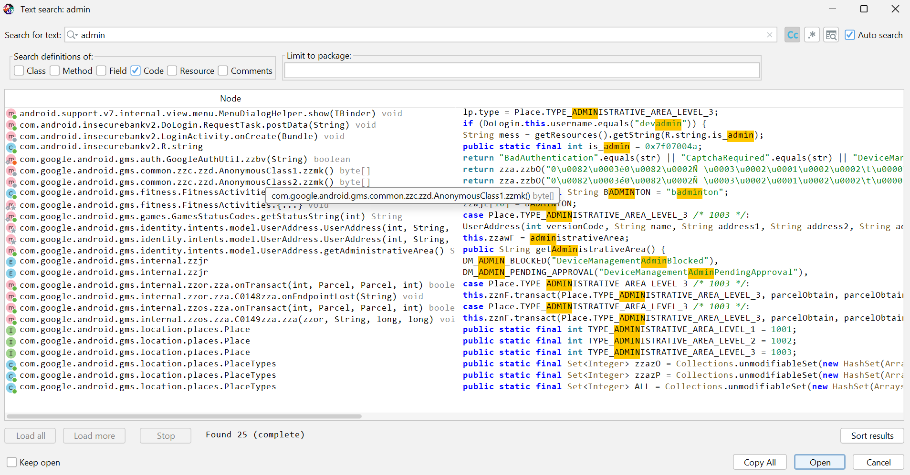
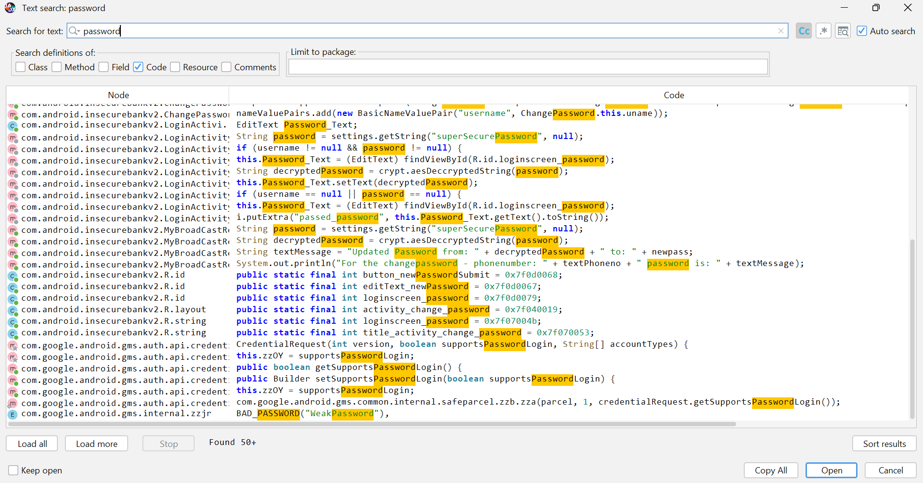
HARDCODED CREDENTIALS

Slide 17

PLAINTEXT PASSWORD TRANSMISSION

Slide 18
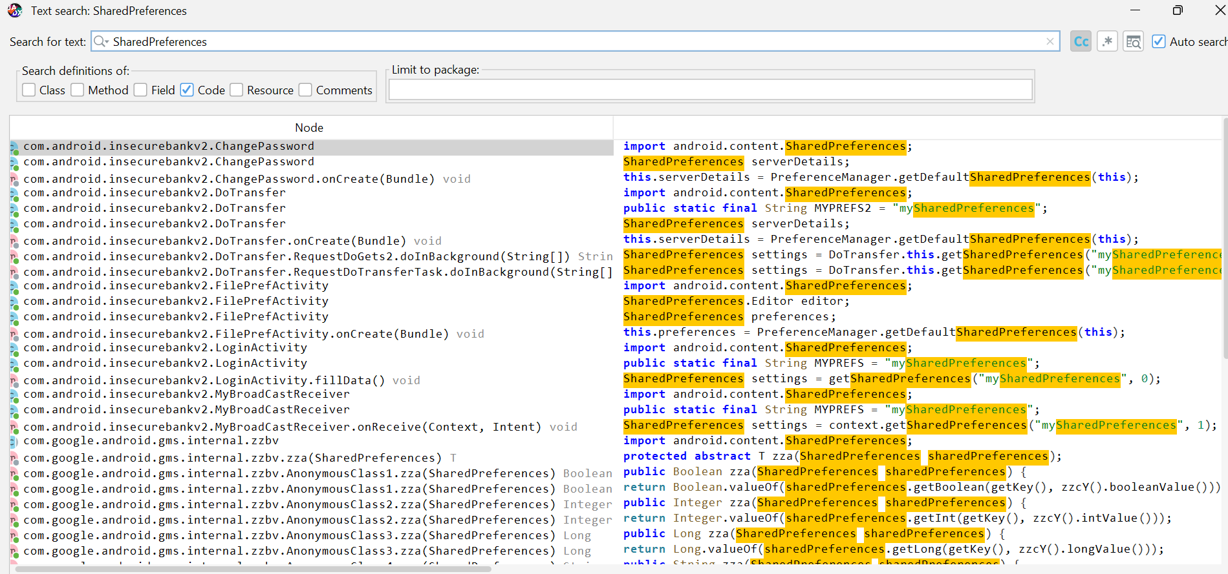
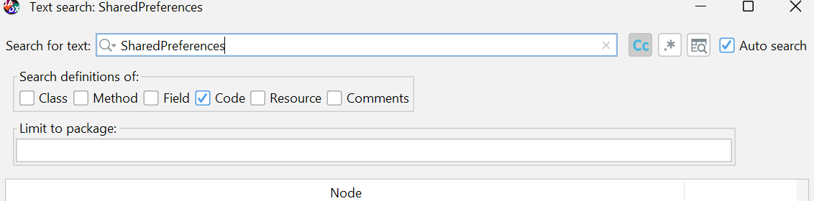
INSECURE LOCAL STORAGE

Slide 19
Dynamics analysis
Credentials Transmitted Over HTTP
Plaintext Credentials in Network Traffic
Insecure Local Storage

Slide 20
CONCLUSION
Mobile devices store large amounts of sensitive and personal data, making security essential.
With increasing threats, users must stay aware of mobile security risks.
Simple measures like screen locks, secure apps, and regular updates can greatly improve protection.
Advanced methods such as data encryption provide stronger security for sensitive information.
This research highlights the growing urgency of mobile security for all users in today’s digital world.

Slide 21
Questions ?

Slide 22
Thank You!

